Slide 1




Turning System KPI’s into Business Growth for Law Firms
GET A GRIP
David Mitroff, Ph.D.
David@PiedmontAve.com
www.PiedmontAve.com

Slide 2

A comprehensive strategy for taking your law firm to the next level requires leaders to know which key areas to focus on. Managing Partners, leaders and administrators need to make important decisions, quickly, with greater consequences, and often with limited information on hand, especially during challenging times. Learn the Key Performance Indicators (KPI’s) and quantifiable measurements that reflect the critical success factors of a law firm business. This session will provide real-world examples and techniques for leveraging existing resources and a systematic approach to growing your law firm.
David@PiedmontAve.com
www.PiedmontAve.com

Slide 3
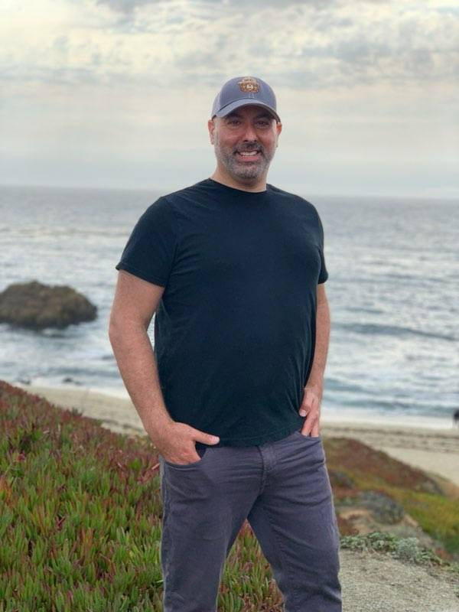



Founder of 7+ Companies including consulting and marketing firm, recruiting and staffing firm, event planning company, hotel and restaurant collective, and more
College Instructor at University of California at Berkeley and Google Mentor for Google for Startups
Tedx Speaker who motivates change through keynote talks, workshops and business consulting
Author of several books including Law Firm Business Growth Strategies and has been featured as expert for NBC, ABC, Inc. Magazine, Washington Post, Chicago Tribune, California Lawyer, Westlaw Today and more
Extensive educational background, which includes a Doctorate in Clinical Psychology and specialized training in Forensic Psychology
David Mitroff, Ph.D.
510-761-5895
David@PiedmontAve.com
www.PiedmontAve.com
David@PiedmontAve.com
www.PiedmontAve.com

Slide 4

Overview
Mindset: Right Now
The 5 Key Law Firm System Wide KPI’s
  Marketing, Client Engagement, Finances, Employee Productivity, Innovation & Technology
Evaluate & Adjust KPI’s for Success
New Ways to Monitor and Increase your Team’s Productivity
Opportunities that COVID and Virtual Work Environment have created for Expansion
How to Keep and Maintain Talent
New Ways to Engage with Clients and Virtual Networking
David@PiedmontAve.com
www.PiedmontAve.com

Slide 5

IN
ON
Day to Day Tasks
Growing Business
David@PiedmontAve.com
www.PiedmontAve.com

Slide 6
Right Now
Business Growth
New Business Growth Cycle
Focus: List of 10 Things You Can Control
Consistency: 3 Lunch Meetings with Strategic Partners per month x 12 months = 36 meetings (Virtual check-in)
- Top 20 List
Top of Mind: Monthly Newsletter (now 1 a week)
The Event Effect: Events and Workshops (virtual events)
More Selective
Charge More
Less Selective
Charge Less
David@PiedmontAve.com
www.PiedmontAve.com

Slide 7

5 Key KPI’s to Evaluate
01
David@PiedmontAve.com
www.PiedmontAve.com

Slide 8
KPI
Key Performance Indicators
Set of quantifiable measurements used to gauge a company's overall long-term performance.
KPIs specifically help determine a company's strategic, financial, and operational achievements, especially compared to those of other businesses within the same sector.
David@PiedmontAve.com
www.PiedmontAve.com

Slide 9

1
Marketing
Strong Online Presence
Building a Marketing Plan
Correct Marketing Tools
Conversion Rates
Search Engine Results
Qualified Leads
David@PiedmontAve.com
www.PiedmontAve.com

Slide 10
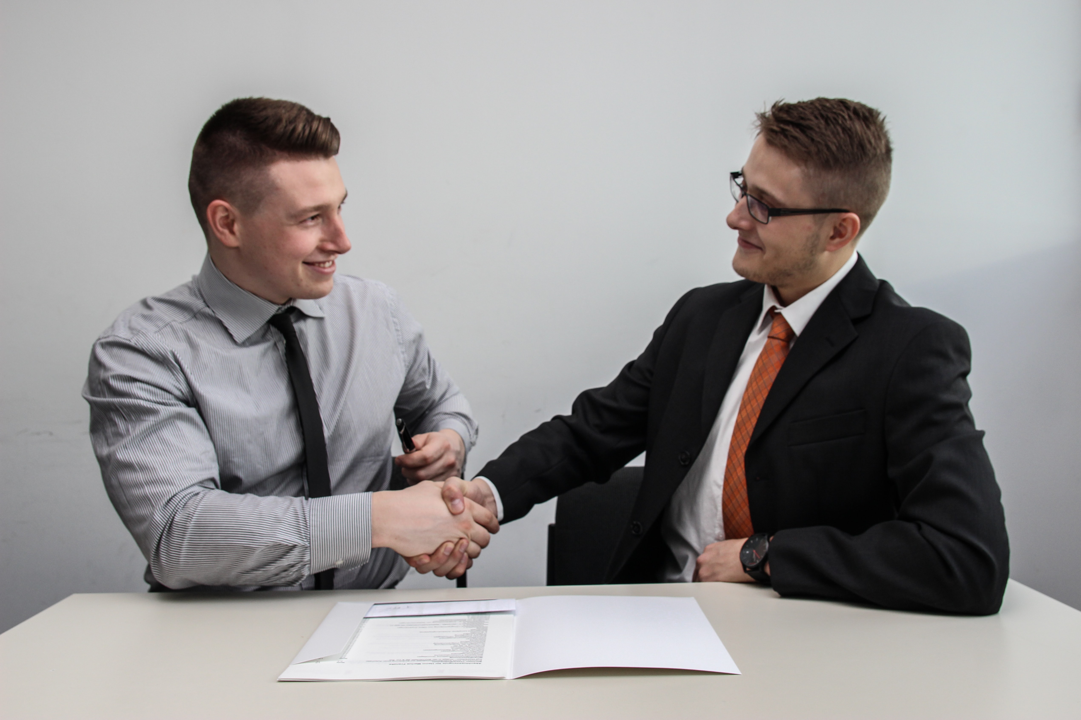
2
Client Engagement
Unique ways to Engage Clients
Exploring Virtual Options
Number of Strategic Partners: Top 20 List
Email Marketing activities
Events lead to one on one meetings
David@PiedmontAve.com
www.PiedmontAve.com

Slide 11

3
Finances
Identify where to improve based on KPI
What is worth investing in?
Where should your focus be?
Profit Margin (PM)
Revenue Per Client (RPC)
David@PiedmontAve.com
www.PiedmontAve.com

Slide 12
4
Employee Productivity
Update your tools
Timelines
Goals
Employee Churn Rate
Employee Satisfaction Rating
David@PiedmontAve.com
www.PiedmontAve.com

Slide 13

5
Innovation & Technology
What tools work for your business to identify your KPI’s?
What tools can you use to automate your business and give more time for engagement strategies?
David@PiedmontAve.com
www.PiedmontAve.com

Slide 14



Clear Communication
What Makes Your Business
STAND OUT?
Brand Creditability
Technology/Innovation
David@PiedmontAve.com
www.PiedmontAve.com

Slide 15
02
Evaluate & Adjust KPI’s for Success
David@PiedmontAve.com
www.PiedmontAve.com

Slide 16
David@PiedmontAve.com
www.PiedmontAve.com

Slide 17

David@PiedmontAve.com
www.PiedmontAve.com

Slide 22
80 / 20 RULE
20%
80%
With 20% of the data
You will know 80% of what’s happening
David@PiedmontAve.com
www.PiedmontAve.com

Slide 23
03
New Ways to Monitor and Increase your Team’s Productivity
David@PiedmontAve.com
www.PiedmontAve.com

Slide 24
SCORECARD: Campaign Planning
Measurement Hierarchy
Metrics that are leading measures
Examples: brand awareness, CSAT, CLTV, test-drive
STRATEGIC
Forward-Looking Metrics
Metrics that measure specific campaign and tactic effectiveness
Examples: sales, lead conversion
TACTICAL
Backward-Looking Metrics
Metrics that measure the execution efficiency
Examples: take rate, ad dollars spent, cost to serve
OPERATIONAL
Internal-Looking Metrics
David@PiedmontAve.com
www.PiedmontAve.com

Slide 25

SCORECARD: Campaign Planning
Strategic = forward looking metrics
i.e. evaluating brand awareness
David@PiedmontAve.com
www.PiedmontAve.com

Slide 26
SCORECARD: Campaign Planning
Tactical = Backward looking metrics
i.e. # of sales made, clients secured
David@PiedmontAve.com
www.PiedmontAve.com

Slide 27
SCORECARD: Campaign Planning
Operational = internal metrics
i.e. evaluating the success of marketing campaigns
David@PiedmontAve.com
www.PiedmontAve.com

Slide 28
04
Opportunities that COVID and Virtual Work Environment have created for Expansion
David@PiedmontAve.com
www.PiedmontAve.com

Slide 29



When lawyers do work across specialties, their firms earn higher margins, clients are more loyal, and individual lawyers are able to charge more for the work that they do.
Harvard : Teamwork and Collaboration V1 Issue 6
David@PiedmontAve.com
www.PiedmontAve.com

Slide 30
In a World of Remote Work, Abundant Technological Resources, and the need for Isolation and Recovery, Maintaining and Promoting Human Connection is Key and Personal.
David@PiedmontAve.com
www.PiedmontAve.com

Slide 31

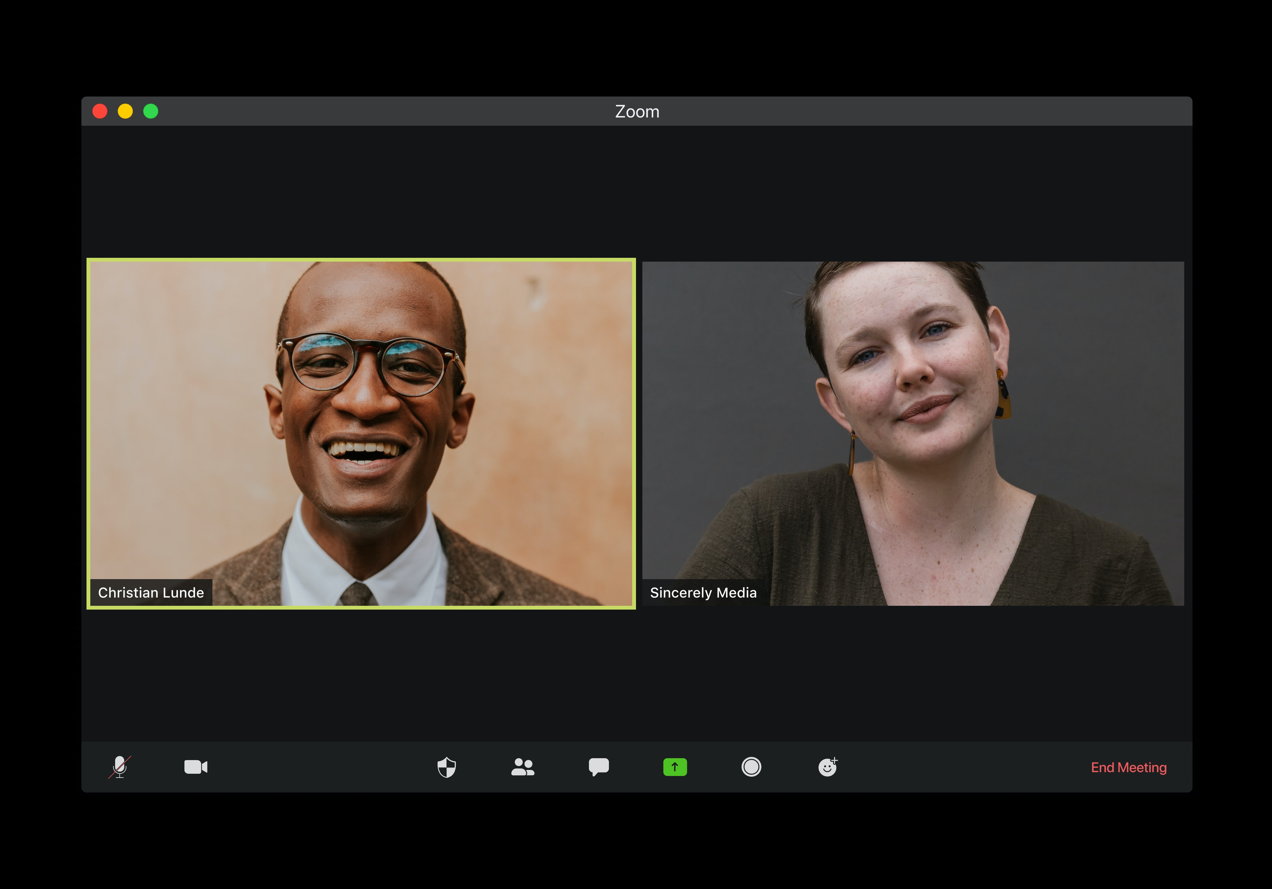
Maintain communication with your team members.
Be clear and transparent.
Over-communicating is better than under-communicating.
Still have coffee chats to network,
even if that means it has to be virtual!
David@PiedmontAve.com
www.PiedmontAve.com

Slide 32

Remote Work Habits May Stick
Education Online
Remote Conferencing and Virtual Networking
Remote Work Becoming Mainstream
David@PiedmontAve.com
www.PiedmontAve.com

Slide 33
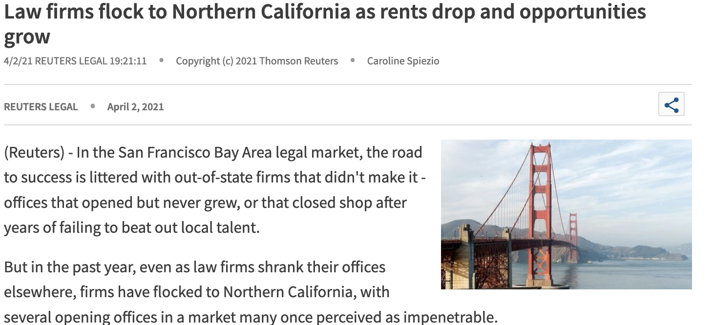
Expanding into New Markets
Thomson Reuters
Westlaw Today
"It's much easier to open a new location right now than it's ever been," said David Mitroff, who advises law firms as founder of Piedmont Avenue Consulting Inc. He pointed to low prices - San Francisco saw a 23% decline in rents over 2020, according to data posted online by Norada Real Estate Investments - and less in-person competition from local law firms.
David@PiedmontAve.com
www.PiedmontAve.com

Slide 34
05
Keep and Maintain Talent
David@PiedmontAve.com
www.PiedmontAve.com

Slide 35

Help your associates build upon their own goals.
Encourage enthusiasm.
David@PiedmontAve.com
www.PiedmontAve.com

Slide 36

Associates want to continue Learning and working towards their own Growth
Create a growth plan for your team
Systematic check-ins (30, 60, 90 for new hires)
Create and manage short-term and long-term goals
Train on all resources to set up employees for success
What strengths can you identify?
How can you utilize those strengths for your business and for their growth?
David@PiedmontAve.com
www.PiedmontAve.com

Slide 37
06
New Ways to Engage with Clients and Virtual Networking
David@PiedmontAve.com
www.PiedmontAve.com

Slide 38

Who is your Target Market?
How do you Reach them?
How do you Reach New Markets?
Market Segmentation – Dividing a target market into smaller, more defined categories.
David@PiedmontAve.com
www.PiedmontAve.com

Slide 39

Find Relationships that will Benefit You and Your Business.
List 20 of them.
TOP 20 LIST
Examples depend on your business:
Financial Advisors
Other Attorneys
Insurance Companies
Accountants
Tip: Use Linkedin to find more!
David@PiedmontAve.com
www.PiedmontAve.com

Slide 40

Analyze your Current Market.
What do you do that keeps people engaged?
How are you unique?
What are you doing to maintain those relationships?
THEN Speak Directly to your Desired Market.
David@PiedmontAve.com
www.PiedmontAve.com

Slide 41


Email Marketing Strategy
Easy tools for keeping track of your lists
Make email campaigns look professional
Track your open and click rates easily
David@PiedmontAve.com
www.PiedmontAve.com

Slide 42


Host Remote Events
Reinforcement and enhancement of brand awareness -
Throwing an event will help you get your company in the eye of more people.
Lead generation - You can target people and follow up with them after the event.
Creation of better relationships - Meet people who are interested in similar things as you and your business.
Collaboration with others and development of partnerships
Letting your audience know what’s going on - Use Social Media to publicize and make it easy for your audience to find out what’s going on with your business.
Feature events where attendees can participate in the comfort of their own home
David@PiedmontAve.com
www.PiedmontAve.com

Slide 43

Get Invited to Events
Subscribe to Email Newsletters
Being a follower has benefits
Follow Companies on Facebook
Company Facebook pages will often post events on their pages!
Conference Sponsors
Sponsors who attend various conferences normally have private or exclusive events hosted by them for attendees.
Mentioning that you would like to have a conversation will often open an invite to attend the event, where it is an easy way to discuss business.
David@PiedmontAve.com
www.PiedmontAve.com

Slide 44
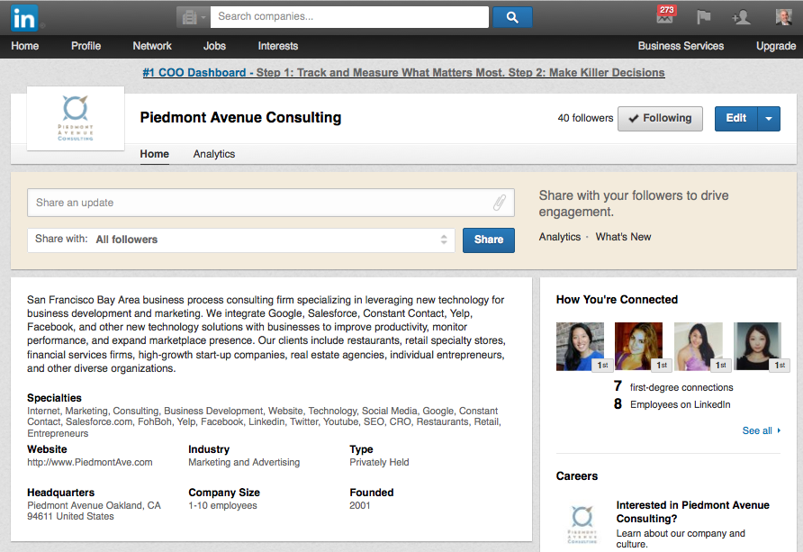
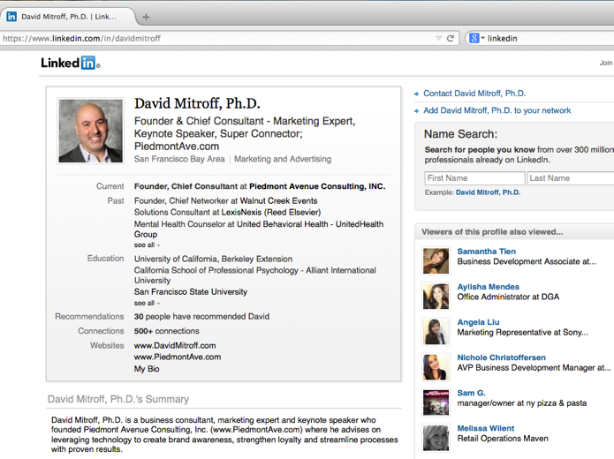
Leverage Linkedin
    Find individuals you know in a professional capacity
    Free personal profile AND company profile
    Participate in discussions
    Invite people events
    Grow your Top 20 Strategic Partners List
David@PiedmontAve.com
www.PiedmontAve.com

Slide 45
Right Now
Grow Your Business
New Business Growth Cycle
Focus: List of 10 Things You Can Control
Consistency: 3 Lunch Meetings (Virtual check-in) per month x 12 months = 36 meetings
Top of Mind: Monthly Newsletter (now 1 a week)
The Event Effect: Events and Workshops (virtual events)
More Selective
Charge More
Less Selective
Charge Less
David@PiedmontAve.com
www.PiedmontAve.com

Slide 46
Overview
Mindset: Right Now
The 5 Key Law Firm System Wide KPI’s
  Marketing, Client Engagement, Finances, Employee Productivity, Innovation & Technology
Evaluate & Adjust KPI’s for Success
New Ways to Monitor and Increase your Team’s Productivity
Opportunities that COVID and Virtual Work Environment have created for Expansion
How to Keep and Maintain Talent
New Ways to Engage with Clients and Virtual Networking
David@PiedmontAve.com
www.PiedmontAve.com

Slide 47
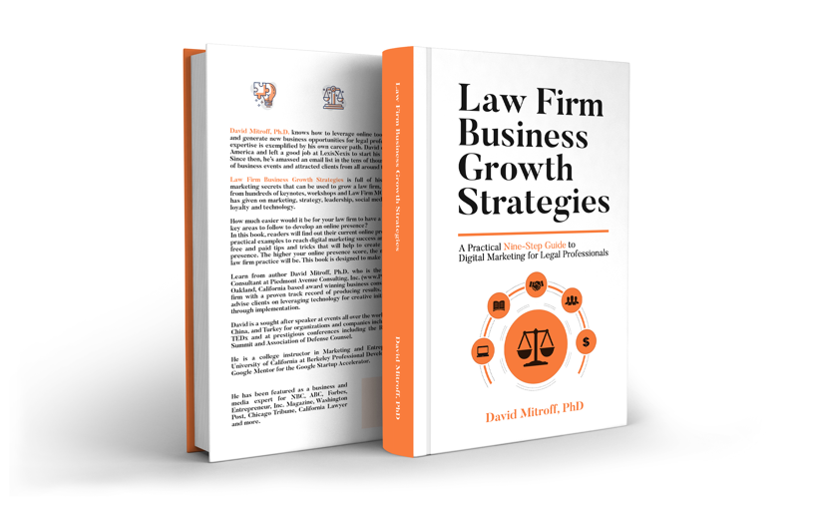
Available on Amazon OR email David@PiedmontAve.com to get your FREE PDF
Have more specific questions? Schedule free Consultation call at: www.PiedmontAve.com
David@PiedmontAve.com
www.PiedmontAve.com

Slide 48
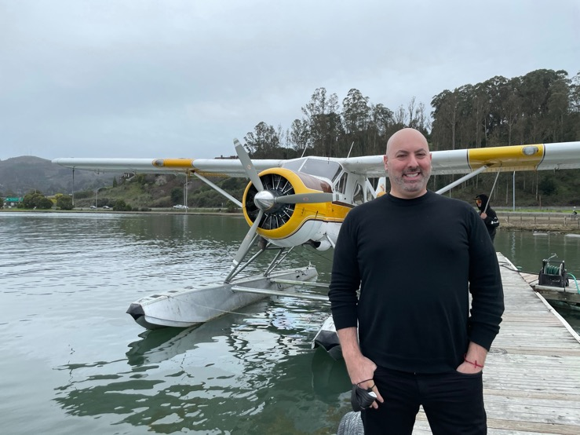
Keep In Touch
510-761-5895
David@PiedmontAve.com
www.PiedmontAve.com
www.PiedmontAve.com
Learn more at
www.PiedmontAve.com/Law
David@PiedmontAve.com
www.PiedmontAve.com

